Slide 1
Unit 1. Problem Solving with Computer

Slide 2
Intro
Number of problems in our daily life.
Suppose we have to calculate Simple Interest.
Suppose we have to prepare a mark sheet.
A computer is a DUMB machine.
A computer cannot do anything alone without software i.e. Program

Slide 3
A software is a set of programs written to solve a particular problem
Software is a set of instructions on the basis of which computer gives output/result.
If the instructions are not correct, the computer gives wrong result.

Slide 4
Never Ever Forget
Just writing code is not sufficient to solve a problem.
Program must be planned before coding in any computer language available.
There are many activities to be done before and after writing code.

Slide 5
Stages while solving a problem using computer
Problem Analysis
Algorithm Development
Flowcharting
Coding
Compilation and Execution
Debugging and Testing
Documentation

Slide 6
Fig. Steps in problem solving
Problem Analysis
Algorithm Development
Flowcharting
Program Coding
Compilation and Execution
Debugging and Testing
Documentation

Slide 7
1. Problem Analysis
Process of becoming familiar with the problem.
We need to analyze and understand it well before solving.
The user’s requirements cannot be fulfilled without clear understanding of his/her problem in depth.
Inadequate identification of problem may cause program less useful and insufficient.
Example: Banking Solution, Hospital Medical Study

Slide 8
Algorithm Development
Step By Step description of the method to solve a problem.
Effective procedure for solving a problem in finite number of steps.
Developing an algorithm is a step of program design.

Slide 9
An algorithm if students are getting bored:
Step1: Start
Step2: Teacher reading out loud to the class
Step3: If Students are yawning at the last seat of theirs, ask them a question or goto step5
Step4: Ask them question, if they don’t answer goto step 3.
Step5: If time left got to step2 else goto step6.
Step6: END

Slide 10
Three features of Algorithm
Sequence
Each step in the algorithm in executed in specified order. If not algorithm will fail.
Decision
We have to make decision to do something.
If the outcome of the decision is true, one thing is done otherwise other.
If condition then process1
OR
If condition
Then process1
Else process2
Repetition
For example
Repeat
Fill Water in the kettle
Until Kettle is full

Slide 11
Flowcharting
Graphical representation of an algorithm using standard symbols.
Includes a set of various standard shaped boxes that are interconnected by flow lines.
Flow lines have arrows(direction of flow).
Activities are written within boxes in English.
Communicates between programmers and business persons.

Slide 12
Advantages of Flowcharts
Communication
Quickly provide logic, ideas and descriptions of algorithms.
Effective Analysis
Clear overview of the entire problem.
Proper Documentation
Documents the steps followed in an algorithm.
Helps us understand its logic in future.
Efficient Coding
More ease with comprehensive flowchart as a guide
Easy in debugging and program maintenance
Debugging and maintenance of operating program

Slide 13
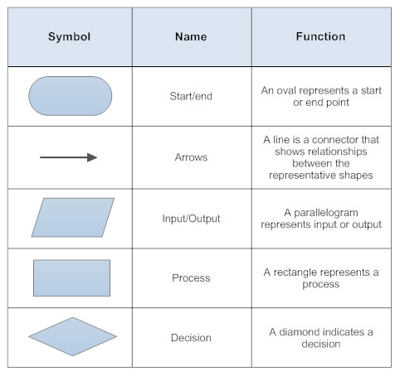
Flowchart Symbols

Slide 14
Things to consider
There should be start and stop to the flowchart.
Only one flow line should emerge from a process symbol.
Only one flow line should enter a decision symbol, but two or three flow lines can leave the decision symbol.

Slide 15
Write an algorithm and draw flowchart for finding the sum of any two numbers.
Algorithm
-------------
Step1: Start
Step2: Display “Enter two numbers”.
Step3: Read A and B
Step4: C= A+B
Step5: Display “C as sum of two numbers”
Step6: Stop

Slide 16
Flowchart
START
Start
Read two
Numbers, A and B
Input
C = A + B
Processing
Display C as Sum of A and B
Output
END
End

Slide 17
Some questions for Homework
Write an algorithm and draw flowchart to determine a number whether it is positive or negative.
Write an algorithm and draw flowchart to test a number for even or odd.
Write an algorithm and draw flowchart to find the largest number among three numbers.

Slide 18
Read N numbers from user and display sum of all entered numbers.
For finding the sum of the series 1+2+3+4+… up to N terms
For calculating the factorial of a given number N.

Slide 19
Coding
The process of transforming the program logic design into computer language format.
An act of transforming operations in each box of the flowchart in terms of the statement of the program.
The code written using programming language is also known as source code.
Coding isn’t the only task to be done to solve a problem using computer.

Slide 20
Compilation
Process of changing high level language into machine level language.
It is done by special software, COMPILER
The compilation process tests the program whether it contains syntax errors or not.
If syntax errors are present, compiler can not compile the code.

Slide 21
Execution
Once the compilation is completed then the program is linked with other object programs needed for execution, there by resulting in a binary program and then the program is loaded in the memory for the purpose of execution and finally it is executed.
The program may ask user for inputs and generates outputs after processing the inputs.

Slide 22
Debugging and Testing
Debugging is the discovery and correction of programming errors.
Some errors may remain in the program because the designer/programmer might have never thought about a particular case.
When error appears debugging is necessary.

Slide 23
Debugging and Testing
Testing ensures that program performs correctly the required task.
Verification ensures that program does what the programmer intends to do.
Validation ensures that the program produces the correct results for a set of test data.
Test data are supplied to the program and output is observed.
Expected output = Error free

Slide 24
Program Documentation
Helps to those who use, maintain and extend the program in future.
A program may be difficult to understand even to programmer who wrote the code after some days.
Properly documented program is necessary which will be useful and efficient in debugging, testing, maintenance and redesign process.

Slide 25
Two types of documentations
Programmer’s Documentation (Technical Documentation)
Maintain, redesign and upgrade
Logic, DFD, E-R, algorithm and flowchart
User Documentation (User Manual)
Support to the user of the program
Instructions for installation of the program

Slide 26
Computer Program and Programming Language

Slide 27
Set of instructions that causes to behave in predetermined manner.
To instruct a computer to perform a certain job, we need languages, but not English or Nepali.
We need languages understood by the computer.

Slide 28
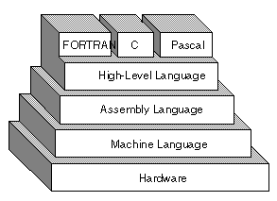
Types or levels of Programming Languages
High Level
Low-level
Machine Level
Assembly Level

Slide 29
Low Level Language
Statement or instruction is directly translated into a single machine code.
It is machine dependent, i.e. A particular low-level language works only for a certain machine.

Slide 30
Machine-level Language
Language that a computer actually understands.
1’s and 0’s.
Is a sequence of instructions written in the form of binary numbers consisting of 1’s and 0’s
It executes fast as computer don’t need any translation.

Slide 31
To add two number in machine language:
11 10111001 110
3 machine code for addition (say) 6
It is difficult to remember different instructions for programming.

Slide 32
Machine Level Language
ADVANTAGE | DISADVANTAGE
Computer directly understands machine instructions | Difficult to use
Directly starts executing | Machine dependent
Takes less execution time | Difficult to Debug and modify

Slide 33
Assembly Language
Symbolic representation(mnemonics) of machine code.
Close to machine code but the computer cannot understand them
Must be translated into machine code by a separate program called an assembler.
11 ADD 110
Suppose ADD is mnemonic for addition

Slide 34
Some examples of instructions for assembly languages are as follows:
CODE | Meaning
ADD | Addition
SUB | Subtraction
INR | Increase
DCR | Decrease
CMP | Compare
It is relatively easy for writing programs in assembly languages, but is slow in execution as it has to be converted into machine language before execution.

Slide 35
Assembly language
Advantage | Disadvantage
More convenient than machine language | Hard to remember Mnemonics
Symbolic instructions | Machine dependent
Improved readability | Less efficient than machine language
Need fewer codes than high level language
Embedded systems and device programming

Slide 36
High Level Language
User friendly, Similar to natural languages
Platform independent
Easy to write or remember
Easy to learn and work
While execution: translated into assembly language then to machine language.
Slow in execution but is efficient for developing programs.
Ex: C, C++, Python, Java etc.

Slide 37
High Level Language
Advantages | Disadvantages
Easy to use | More execution time
Portability | Needs own translator
Easy Debugging
Easy and Fast Development of software

Slide 38
Compiler
A high level source program must be translated into a form machine can understand. This done by software called the compiler.
Source code => Machine language code(Object code)
During the process of translation, the compiler reads the source programs statement-wise and checks for syntax errors.
In case of any error, the computer generates message about the error.
Ex: C, C++, Java, FORTRAN, pascal etc.

Slide 39
Interpreter
Like compiler, it is also a translator which translates high level to machine level language.
Difference in working principle.
Translates and executes the program line by line.
Each line is checked for syntax error and then converted to the equivalent machine code.
Ex. QBASIC, PERL, PHP, ASP

Slide 40
Difference between compiler and interpreter
Compiler | Interpreter
Compiler scans the entire program before translating it into machine code | Interpreter translates and executes the program line by line
Syntax errors are found only after the compilation of complete programs | Syntax errors can be trapped after translations of every line
It takes less execution time | It takes more execution time

Slide 41
Overview to C Programming

Slide 42
C is also called middle level language
This doesn’t mean C is less power full or harder to use or less developed.
Instead C combines the advantages of high level language with the functionalism of assembly language.
Like high level, C provides block structures, stand-alone functions and small amount of data typing.
Like assembly language, it allows manipulations of bits, bytes, pointers and it is mostly used in system programming.
Combination of two aspects.

Slide 43
History of C programming language
C is a programming language which was born at “AT & T’s Bell Laboratory” of USA in 1972.
C was written by Dennis Ritchie, that’s why he is also called as father of C programming language.
C language was created for a specific purpose i.e. designing the UNIX operating system (which is currently base of many UNIX based OS).
From the beginning, C was intended to be useful to allow busy programmers to get things done because C is such a powerful, dominant and supple language.
It’s use quickly spread beyond Bell Labs in the late 70’s

Slide 44
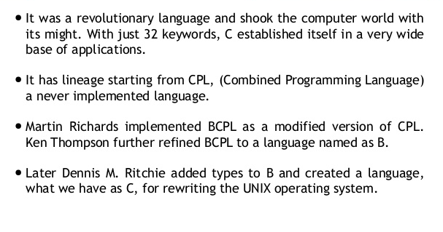
Further Details

Slide 45
Why use C?
Robust Language
Efficient and fast
Highly portable
Structured Language
Extendibility
Middle level language
Rich system library

Slide 46
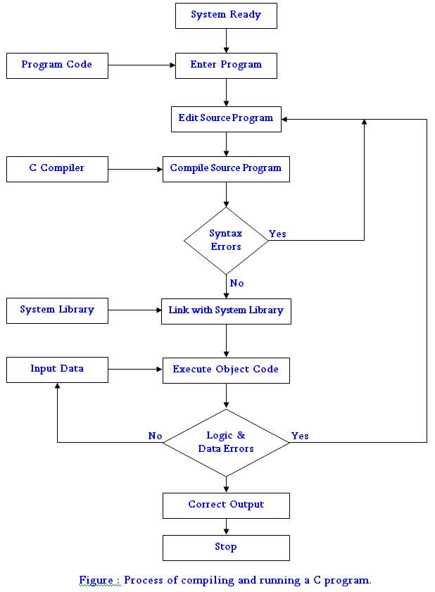
Executing a C Program

Slide 47
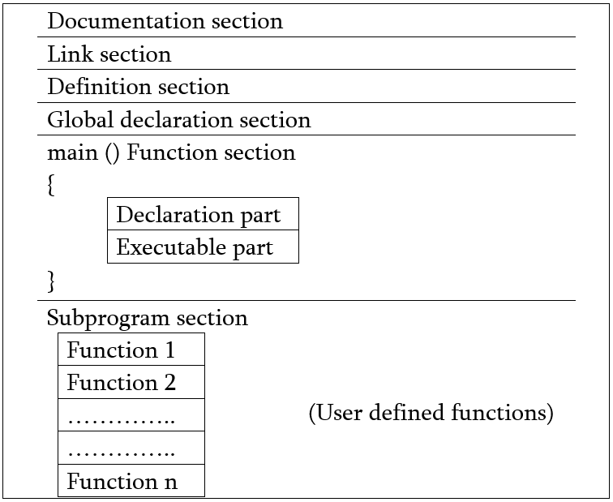
Basic Structure of C Program

Slide 48
1. Documentation Section
Sets of comment line giving the name of program, the author, algorithms, methods used and other details.
Acts as a communication between members of the development team.
Acts as user manual.
Ex
/* This program adds two numbers */
/*…. */ denotes comments in C

Slide 49
2. Link Section
Provides Instructions to the compiler to link functions with program from the system library.
#include<stdio.h>
Links input/output functions like printf() and scanf() with the program

Slide 50
3. Definition Section
In this section all symbolic constants are defined.
Ex.
#define PI 3.1416
#define FORMULA 3*x*x*x+2*x*x

Slide 51
4. Global Declaration Section
The variables which are used in more than one functions or blocks are called global variables.
This section also declares all the user-defined functions.

Slide 52
5. main() Function Section
Every C program starts with a main() function.
Declaration part and executable part
Declaration part declares all the variables used in the execution part.
int n1;
int n2=5;
Execution part has executable operations like:
n1= n1 +1;
n2=n1*5

Slide 53
6. Subprogram Section
This section contains all the user-defined functions that are called in the main function.
All the sections except the main function section may be absent when they are not required.

